Slide 1

Exploring Reinforcement Learning Solutions for EV-aware Optimal Power Flow Under Uncertainty Master Thesis Mid-term Presentation
Chia-Ling Yang
Technical University Munich (TUM)
Chair of Production and Supply Chain Management
Prof. Dr. Martin Grunow
Superviosr: Bahar Okumusoglu
Munich, ^{th} of August 2024

Slide 2
Agenda
Background*
Problem Formulation* (what is challenging)
Literature Review*
Methodology
Implementation – Training Preliminary Result?
Outlook
Chia-Ling Yang | Exploring Reinforcement Learning Solutions for EV-aware Optimal Power Flow Under Uncertainty

Slide 3
Background

Slide 4
Background
Problem Formulation
Literature Review
Methodology
Outlook
Talk about current power grid challenges:
Integration of Renewable energy
Increasing overall power consumption
Increasing power consumption from EV
Chia-Ling Yang | Exploring Reinforcement Learning Solutions for EV-aware Optimal Power Flow Under Uncertainty

Slide 5
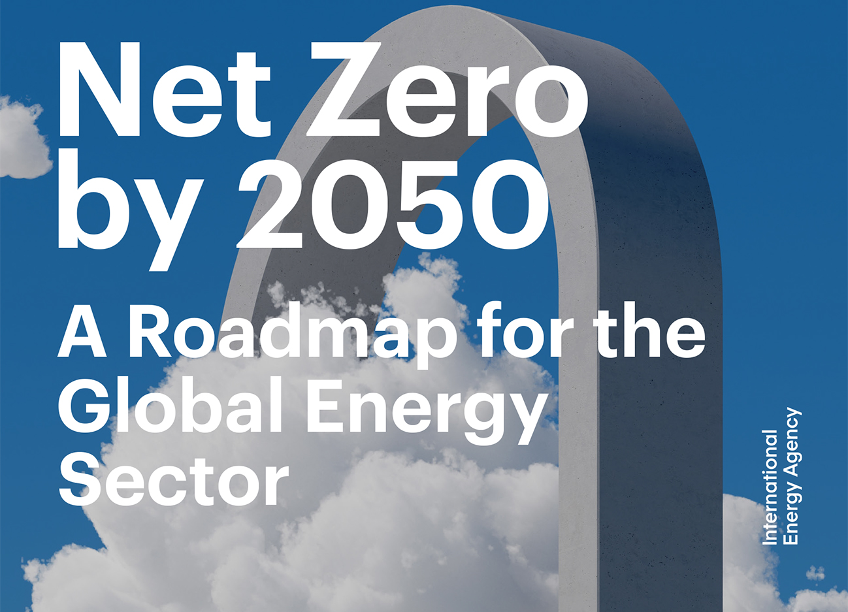
Background
Problem Formulation
Literature Review
Methodology
Outlook
Renewable Energy Integration
(Energy Efficiency Enhancement)
Low Carbon Emission Transportation
Bouckaert et al. "Net zero by 2050: A roadmap for the global energy sector." (2021).
Chia-Ling Yang | Exploring Reinforcement Learning Solutions for EV-aware Optimal Power Flow Under Uncertainty
Notes:
A roadmap for global energy sector proposed by International Energy Agency

Slide 6
“Security- and Human-centered Energy Transition”
Background
Problem Formulation
Literature Review
Methodology
Outlook
IEA (2023), World Energy Outlook 2023, IEA, Paris https://www.iea.org/reports/world-energy-outlook-2023, Licence: CC BY 4.0 (report); CC BY NC SA 4.0 (Annex A)
Rising Penetration of Intermittent Renewable Energy
High Uncertainty of Power Generation
Extreme Weather
Constantly Increasing Energy Demand
Rising Popularity of EVs
Increasing EV Charging Demand
Especially fast charging
Chia-Ling Yang | Exploring Reinforcement Learning Solutions for EV-aware Optimal Power Flow Under Uncertainty
Notes:
Who cares about the problem? Why is the problem important for them?
Important for DSO
If not carefully taken care: cascading failure, prompt break down

Slide 7
Optimal Power Flow
Background
Problem Formulation
Literature Review
Methodology
Outlook
Chia-Ling Yang | Exploring Reinforcement Learning Solutions for EV-aware Optimal Power Flow Under Uncertainty

Slide 8
Optimal Power Flow
Background
Problem Formulation
Literature Review
Methodology
Outlook
Chia-Ling Yang | Exploring Reinforcement Learning Solutions for EV-aware Optimal Power Flow Under Uncertainty

Slide 9
Background
Problem Formulation
Literature Review
Methodology
Outlook
Possible solutions: mathematical optimization v.s. reinforcement learning
Chia-Ling Yang | Exploring Reinforcement Learning Solutions for EV-aware Optimal Power Flow Under Uncertainty

Slide 10






Explain more about RL
$$ℙ(s_{t+1}|s_{t},a_{t})$$
Environment
$$s_{t}$$
$$s_{t+1}$$
$$a_{t}$$
$$r_{t}$$
Agent
$$π(a_{t}|s_{t})$$
Chia-Ling Yang | Exploring Reinforcement Learning Solutions for EV-aware Optimal Power Flow Under Uncertainty

Slide 11








Explain more about RL
$$π(a|s;θ)$$
$$V\left(s;w\right)≅V(s)$$
$$V(s)$$
$$a$$
Actor
Critic
$$a$$
$$r$$
$$s$$
$$s^{′}$$
Environment
Chia-Ling Yang | Exploring Reinforcement Learning Solutions for EV-aware Optimal Power Flow Under Uncertainty

Slide 12
Project Goals
Chia-Ling Yang | Exploring Reinforcement Learning Solutions for EV-aware Optimal Power Flow Under Uncertainty

Slide 13
Problem Formulation

Slide 14
Objective
Chia-Ling Yang | Exploring Reinforcement Learning Solutions for EV-aware Optimal Power Flow Under Uncertainty

Slide 15
Constraints
Chia-Ling Yang | Exploring Reinforcement Learning Solutions for EV-aware Optimal Power Flow Under Uncertainty

Slide 16
Literature Review

Slide 17
Chia-Ling Yang | Exploring Reinforcement Learning Solutions for EV-aware Optimal Power Flow Under Uncertainty

Slide 18
Methodology

Slide 19
Markov Decision Process
Chia-Ling Yang | Exploring Reinforcement Learning Solutions for EV-aware Optimal Power Flow Under Uncertainty

Slide 20
Actor-Critic Framework
Chia-Ling Yang | Exploring Reinforcement Learning Solutions for EV-aware Optimal Power Flow Under Uncertainty

Slide 21
PPO
Chia-Ling Yang | Exploring Reinforcement Learning Solutions for EV-aware Optimal Power Flow Under Uncertainty

Slide 22
Implementation - Training

Slide 23
Critical Components in RL
Environment:
State:
Action:
Reward:
Chia-Ling Yang | Exploring Reinforcement Learning Solutions for EV-aware Optimal Power Flow Under Uncertainty

Slide 24
Uncertainty
Renewable power generation
Power consumption
Charging/discharging demands
Chia-Ling Yang | Exploring Reinforcement Learning Solutions for EV-aware Optimal Power Flow Under Uncertainty

Slide 25
Assumptions
Chia-Ling Yang | Exploring Reinforcement Learning Solutions for EV-aware Optimal Power Flow Under Uncertainty

Slide 26
Neural Network Architechture
Chia-Ling Yang | Exploring Reinforcement Learning Solutions for EV-aware Optimal Power Flow Under Uncertainty

Slide 27
Training Performance
Chia-Ling Yang | Exploring Reinforcement Learning Solutions for EV-aware Optimal Power Flow Under Uncertainty

